Slide 1
Healthcare Analytics
Health effects Pre and Post Covid in Canada

Slide 2
Agenda
Introduction
Primary goals
Analytics
Timeline
Summary

Slide 3
Objective
Main objective is to identify effect on health and their vulnerability on illness. Response of people towards the mental health and their approach before and during pandemic. Here, we have tried to do analysis on the health of people in Canada, pre and post Covid-19.

Slide 4
Dataset and Data Cleaning
Dataset was taken from 2 sources : kaggel and physionet
Pre-Covid19 - https://www.kaggle.com/datasets/anth7310/mental-health-in-the-tech-industry
During Covid19 - https://physionet.org/content/flatten-covid-survey/1.0/
Data Cleaning and preparation was done in excel using powerbi

Slide 5
Primary goals
Analyze overall effects on mental health of people in Canada: Pre and During Covid-19

Slide 6
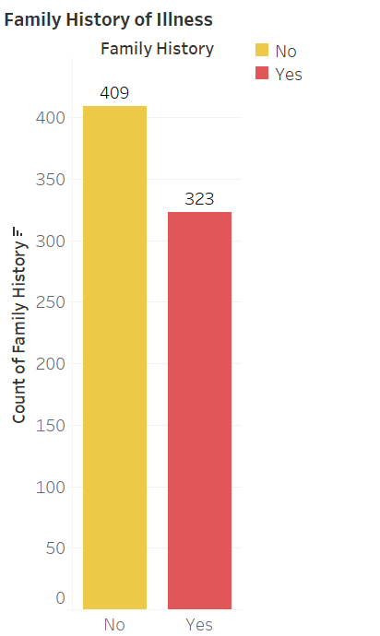
Pre-Covid
About 409 people in survey have family illness while 323 people don’t have any family illness.
Mental Health Pre/During Covid-19

Slide 7
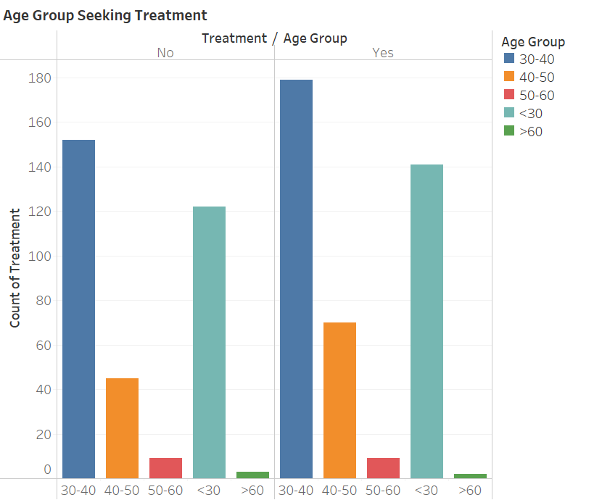
Which age group were taking treatment
From this we can observe that employees within the age of 30-40 were seeking treatment followed by age group less than 30.

Slide 8
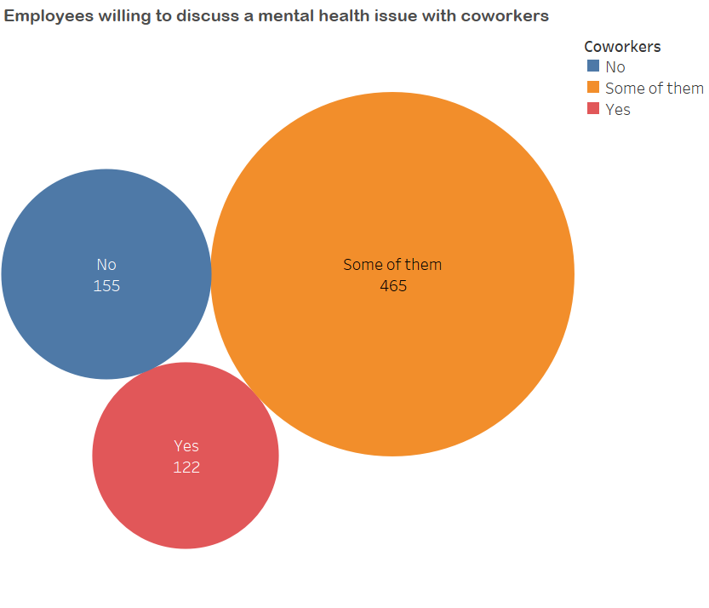
In terms of willingness only few employees would discuss their mental health issue with coworkers, while some of them might or might not discuss their issues with coworkers and the reason could be personal or the trust and relationship between employees.

Slide 9
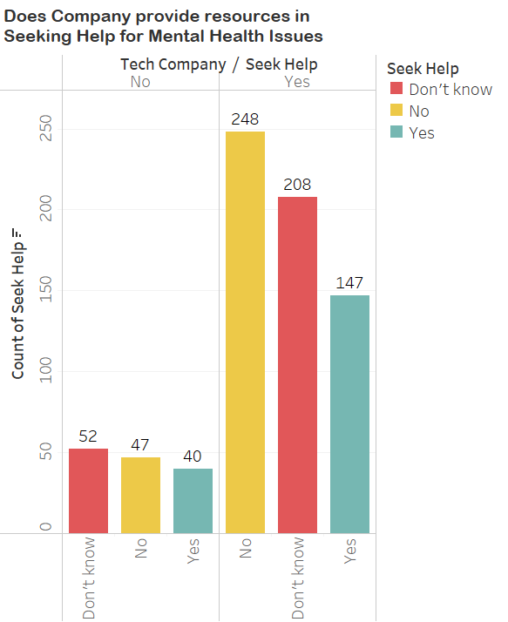
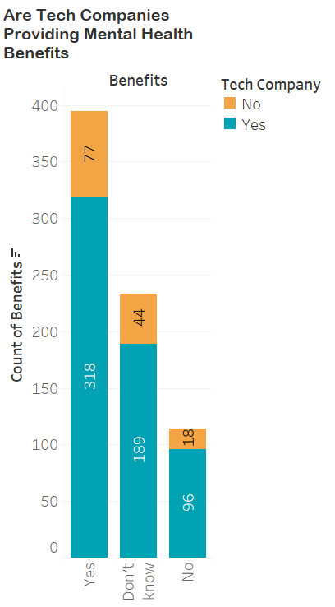
How is Company Treating their Employees ?
Most of the Tech Companies are providing mental health benefits but there is small portion of employees who are not aware whether there is any kind of benefit provided by their company or not. Although benefits are provided but there is lack of resources in accessing those benefits which we can see from chart on left side, depicting that mostly people are not provided resources while some don’t know if there is any kind of resource available.

Slide 10
During Pandemic (Covid-19)
For Covid-19 we have used three datasets containing survey data which was collected through social media platforms and traditional news services.
We will use this datasets to evaluate effect of COVID-19 on mental health during pandemic.
Mental Health Pre/During Covid-19

Slide 11
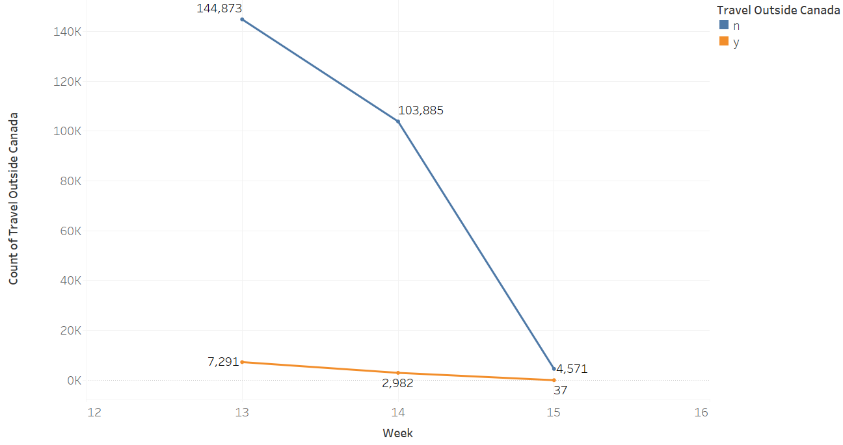
Schema - 1 Effect on Travel
Major portion of people did not travel out of Canada, but , trendline for people who travelled outside Canada declined from week 13 to week 15.
Mental Health Pre/During Covid-19

Slide 12
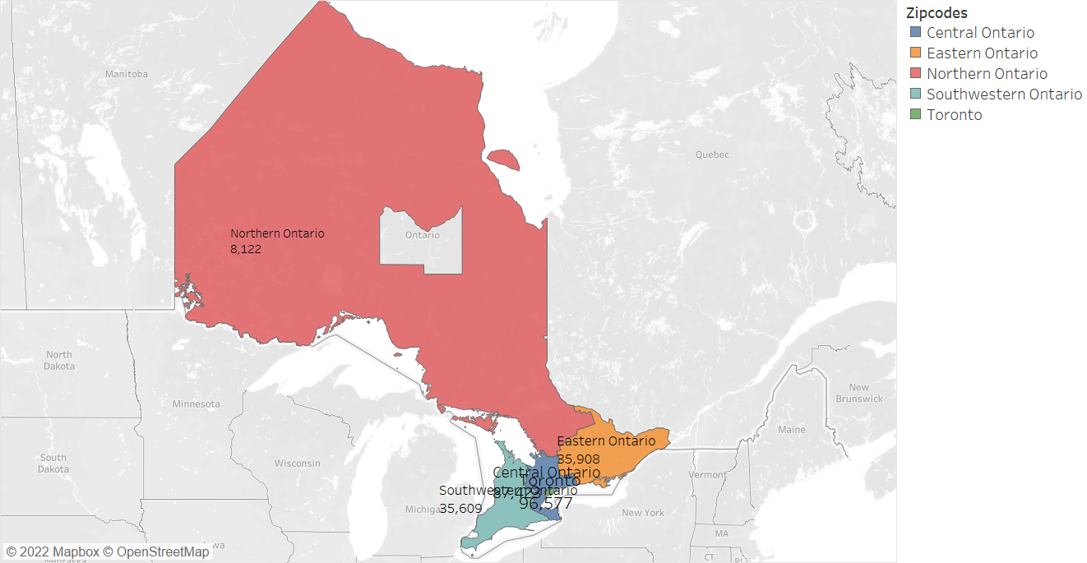
Vulnerability by Zip codes
Toronto(96577) was more vulnerable province in Canada followed by Eastern Ontario(35908). While Northern Ontario was least vulnerable(8122)

Slide 13
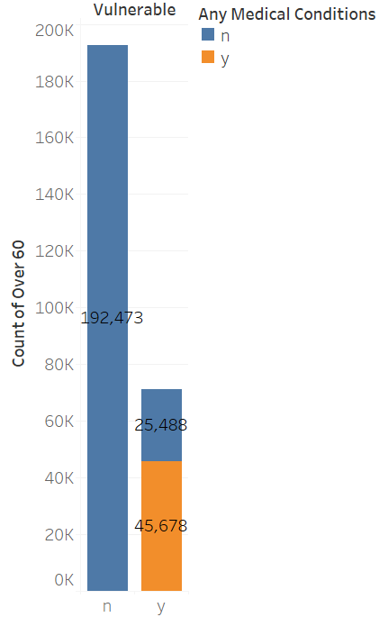
Effect of Medical Condition on Vulnerability
People who had any kind of medical condition were more vulnerable as compare to people with no medical condition.

Slide 14
Schema – 2
Schema 2 contains survey data from week 16. Here, we can see that age group of people 26-44 were more involved in survey.

Slide 15
In Week 16 very less number of people travelled out of Canada reason being lockdown and restriction on different travelling modes like by air, land etc.

Slide 16
Gender vs Illness
According to the chart, more females were contacted with the illness than males. Although major population was not at all contacted with illness

Slide 17
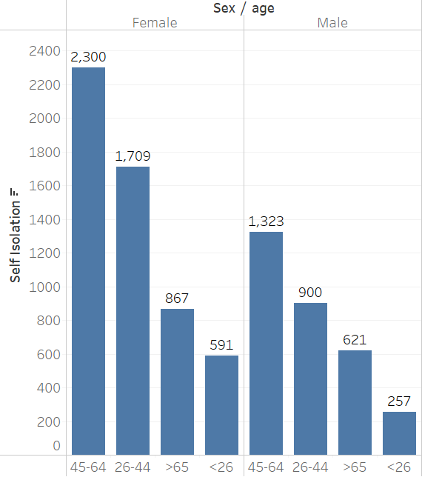
Schema - 3
It contains data after week 16 from the months of April, May, and June. In this, age group of 45-64, both in males and females followed self-isolation during the pandemic.

Slide 18
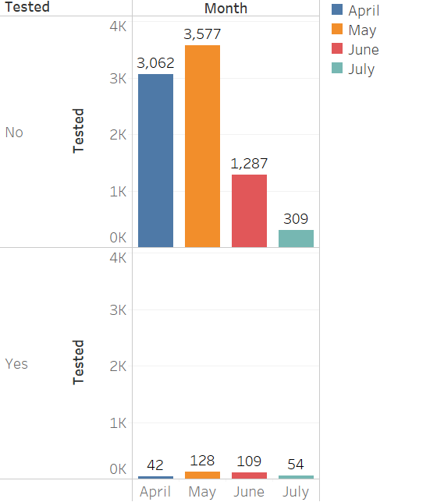
Were they tested for Covid-19?
Although most of the people did not get tested, in the month of May 128 people were tested for Covid-19.

Slide 19
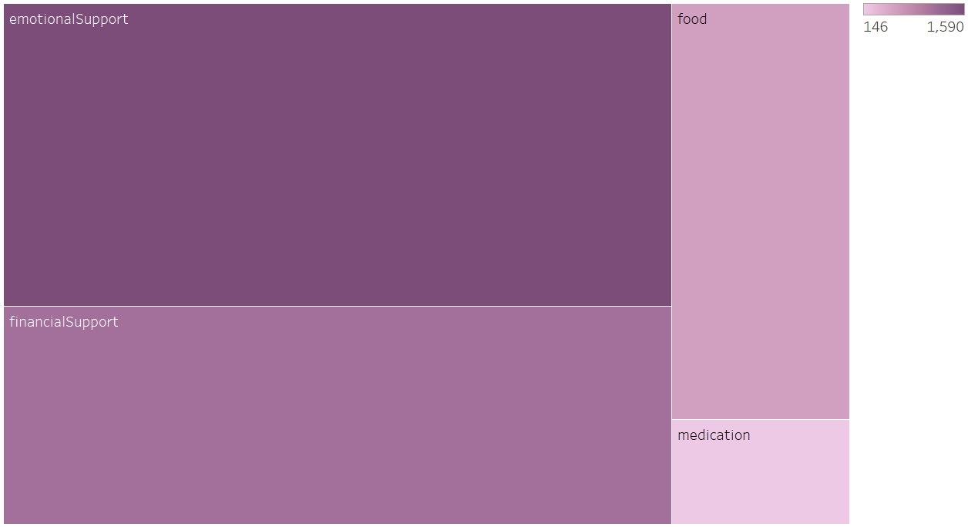
What help was needed?
According to people’s opinion, they needed emotional support the most, then comes financial support while the medication was least in this case.

Slide 20
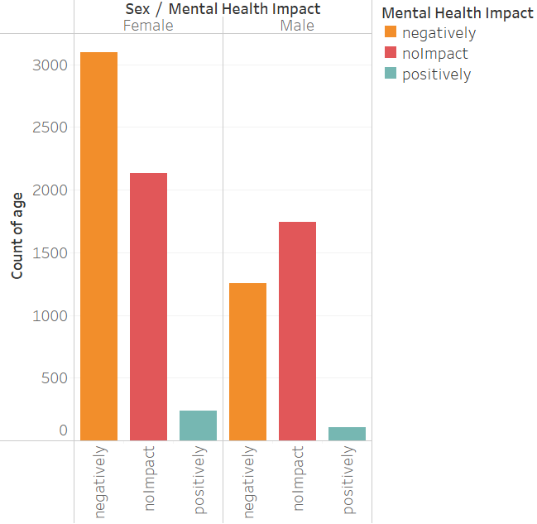
How was mental health impacted?
Covid-19 brought drastic changes in everyone’s lives, this effected Females with more negative impact on mental health than males.

Slide 21
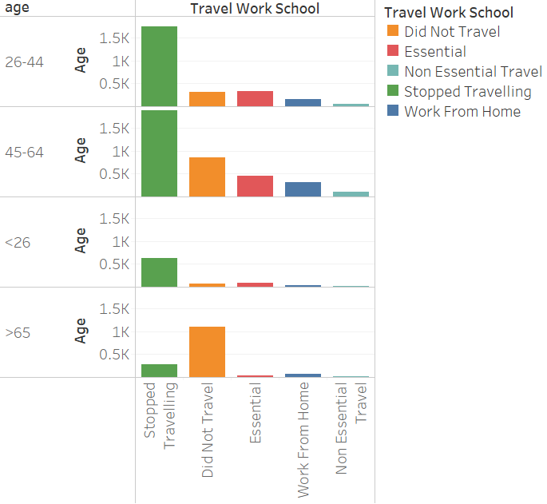
How was the commute?
Most of the population stopped travelling, there was a group of people in the age between 26-44 and 45-64 travelling for essential work. While, others were working from home and non-essential travel was almost negligible.

Slide 22
Timeline
There were drastic changes, travel was stopped, people wanted more emotional support and mental health took a toll.
Before Covid
There were mental health issues but not much was done.
Companies started giving health benefits and resources, but people couldn’t make much of it.
Post Covid-19

Slide 23
Conclusion
Before the pandemic people had benefits but not much resources were available to access it, people were not comfortable seeking help for mental health issues. Covid-19 brought to attention over the period that people need emotional support, and they are asking for help. Mental health was deteriorating, and people became more vulnerable to illness.

Slide 24
References
Pre-Covid19 - https://www.kaggle.com/datasets/anth7310/mental-health-in-the-tech-industry
During Covid19 - https://physionet.org/content/flatten-covid-survey/1.0/

Slide 25
Thank you
Group 4 – Section 003
Shraddha Kolte – 0789558
Manpreet Kaur – 0784694
Khushbeer Kaur – 0786988
Gagandeep Kaur - 0792023

